Slide 1
CSC 578 Neural Networks and Deep Learning
Fall 2018/19
1. Intro to Neural Networks
(Some figures adapted from Tom Mitchell @ CMU)

Slide 2
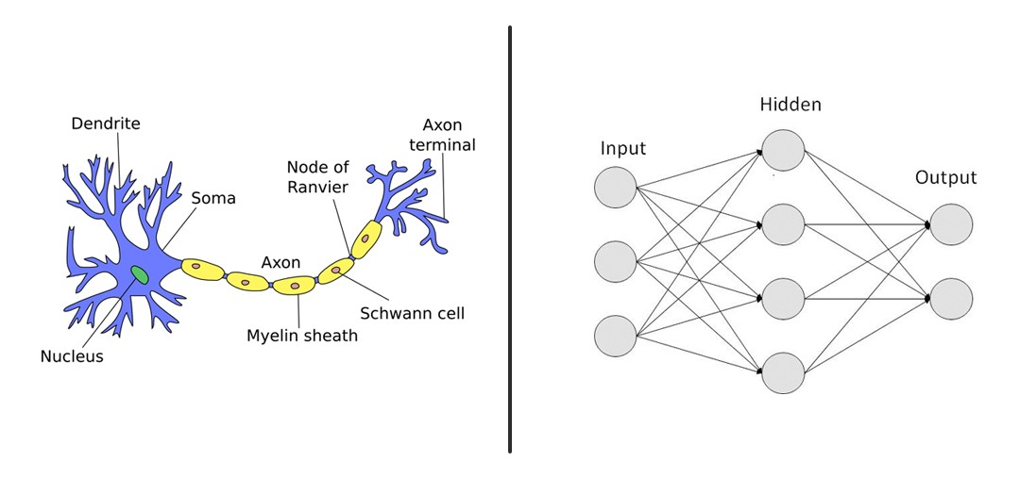
Neural Networks
Origin of Neural Networks – AI [since 1940’s]:
“Artificial neural networks (ANN) or connectionist systems are computing systems vaguely inspired by the biological neural networks that constitute animal brains.” [Wikipedia]

Slide 3
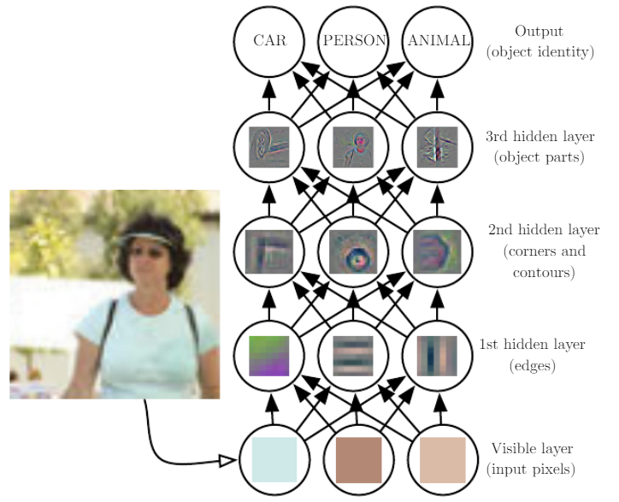
Modern Neural Networks – Data Science (from Machine Learning) [since 1990’s but mostly after 2006] “until 2006 we didn't know how to train neural networks to surpass more traditional approaches, except for a few specialized problems. What changed in 2006 was the discovery of techniques for learning in so-called deep neural networks.”

Slide 4
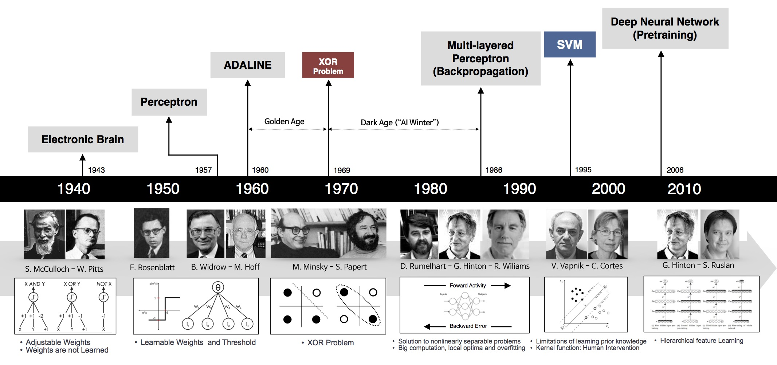
Also a good reference on the history of Neural Networks: “A brief history of Neural Nets and Deep Learning” by A. Kurenkov

Slide 5
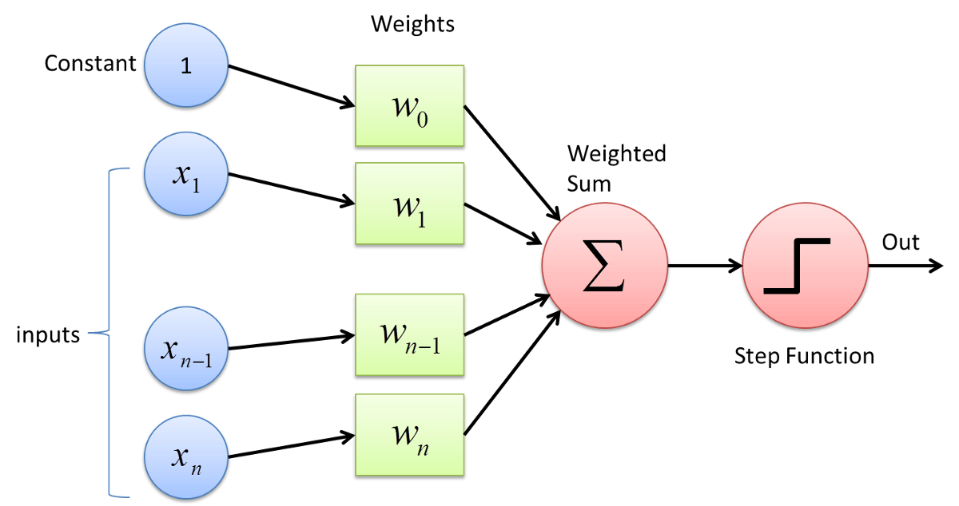
1 Perceptron
Perceptron simulates a human neuron, and is a simple processing unit which produces a one (for ‘on’) or a zero (or minus 1; for ‘off’).
“Perceptron is a single layer neural network and a multi-layer perceptron is called Neural Networks. Perceptron is a linear classifier (binary). ” [source]

Slide 6
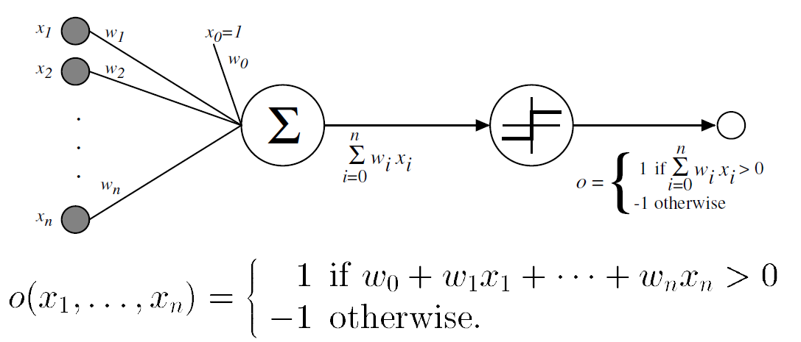

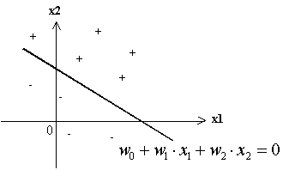
1.1 Decision Surface of Perceptrons
Perceptron (with step-function as the activation function)
So the decision surface is linear. For the case of 2 input units (and the constant unit x₀=1):
represents an inequation:

Slide 7
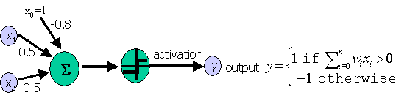
Example: Perceptron which computes AND:
AND x2
^
x1 x2 y |
============= - | +
1 1 1 |
1 -1 -1 --------+---------> x1
-1 1 -1 |
-1 -1 -1 - | -
|
EXERCISE: Draw the decision surface/line for the weights above.

Slide 8
1.2 Expressiveness of a Perceptron
A single Perceptron can represent AND, OR, NAND, NOR.
But it cannot represent XOR (exclusive or) -- because it is NOT linearly separable.
Note: XOR can be represented by a network with multiple perceptrons (to be shown later).
XOR x2
^
x1 x2 y |
============= + | -
1 1 -1 |
1 -1 1 --------+---------> x1
-1 1 1 |
-1 -1 -1 - | +
|

Slide 9
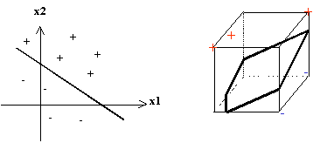

Linear separability:
In n dimensions, the relation w•x=q (i.e., $\sum_{i=0}^{n}{w_{i}∙x_{i}=q}$) defines a n-1 dimensional hyper-plane.
If all patterns in a dataset can be separated by a hyper-plane, the dataset is said to be linearly separable.

Slide 10
1.3 Activation Functions & Perceptron Learning
Now we want to automatically derive (i.e., learn) the weights in a single perceptron network for a given set of examples (i.e., training examples).
We start with small (and random) weights, and adjust them iteratively.
Repeat the procedure until the peceptron classifies all training examples correctly.
fn

Slide 11
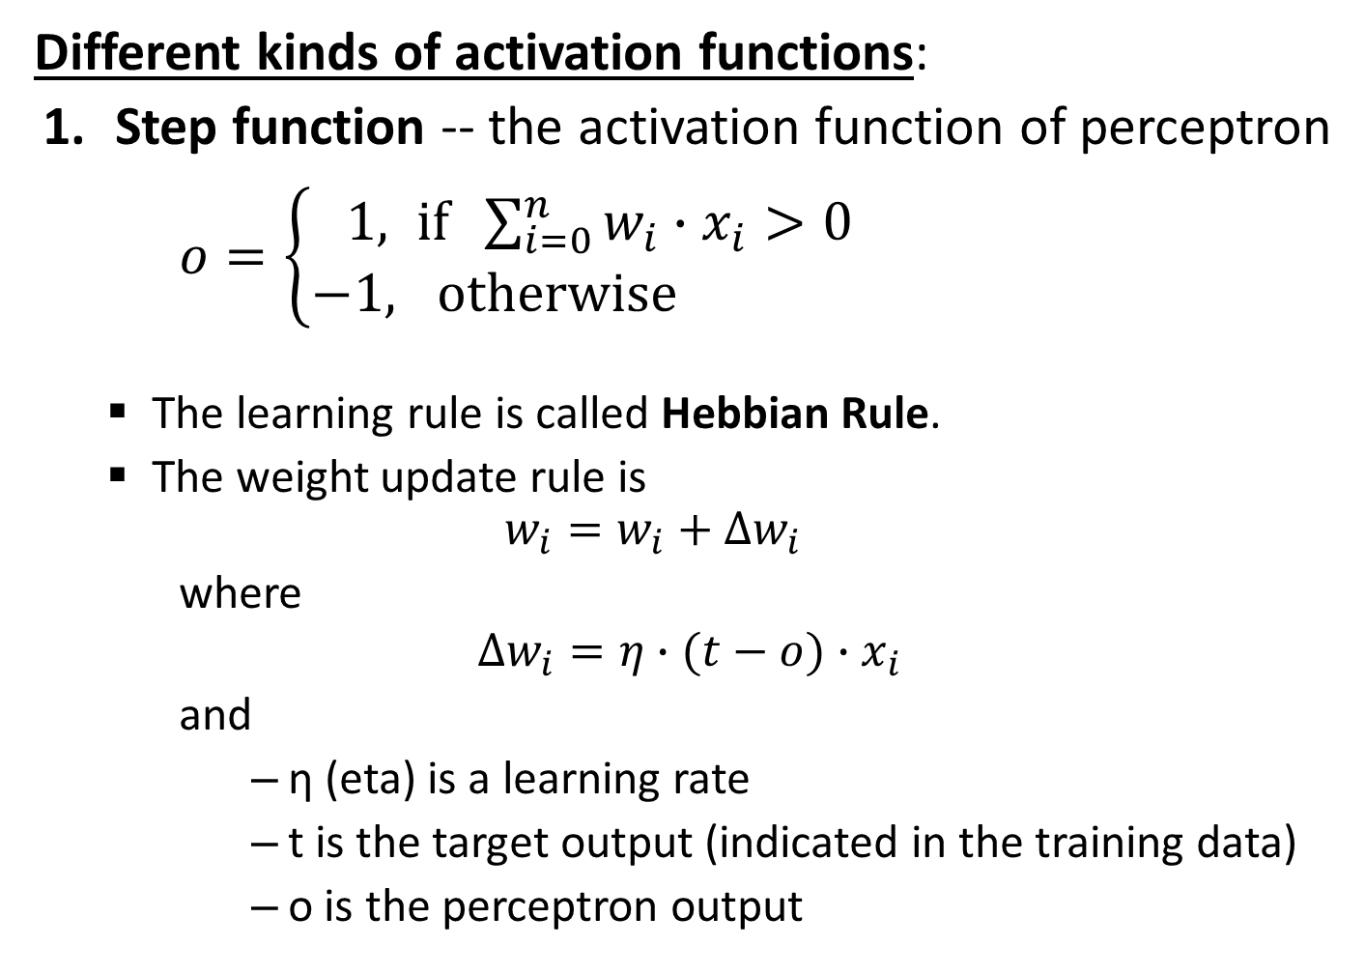
Different kinds of activation functions:
Step function -- the activation function of perceptron
$o=\left\{\begin{aligned}1, if \sum_{i=0}^{n}{w_{i}∙x_{i}>0} \\ −1, otherwise \end{aligned}\right.$
The learning rule is called Hebbian Rule.
The weight update rule is $w_{i}=w_{i}+∆w_{i}$
where
$$∆w_{i}=η∙(t−o)∙x_{i}$$
and
η (eta) is a learning rate
t is the target output (indicated in the training data)
o is the perceptron output

Slide 12
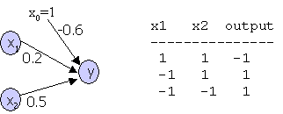
EXERCISE: For the following perceptron with the initial weights, show the changes of weights after each of the three training examples are presented (in that order). Assume the same step function as shown before, and the learning rate (eta) is 0.3.

Slide 13
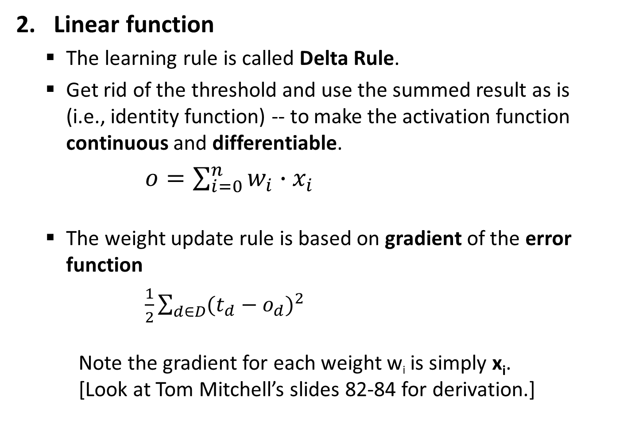
Linear function
The learning rule is called Delta Rule.
Get rid of the threshold and use the summed result as is (i.e., identity function) -- to make the activation function continuous and differentiable.
$o=\sum_{i=0}^{n}{w_{i}∙x_{i}}$
The weight update rule is based on gradient of the error function
$\frac{1}{2}\sum_{d∈D}{{(t_{d}−o_{d})}^{2}}$ Note the gradient for each weight w_{i} is simply x_{i}. [Look at Tom Mitchell’s slides 82-84 for derivation.]

Slide 14
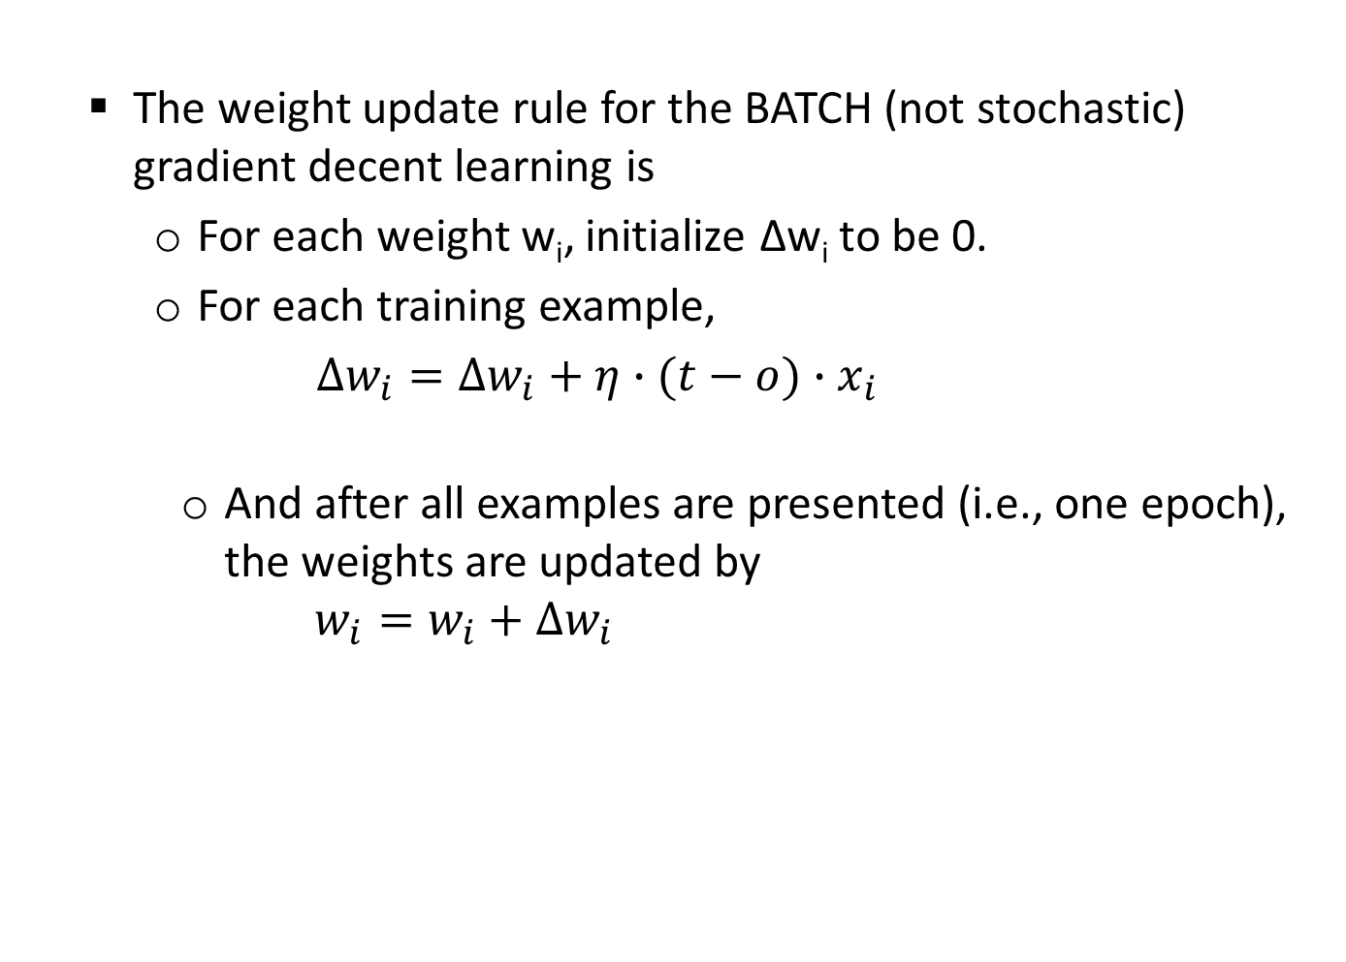
The weight update rule for the BATCH (not stochastic) gradient decent learning is
For each weight w_{i}, initialize ∆w_{i} to be 0.
For each training example,
$∆w_{i}=∆w_{i}+η∙(t−o)∙x_{i}$
And after all examples are presented (i.e., one epoch), the weights are updated by $w_{i}=w_{i}+∆w_{i}$

Slide 15
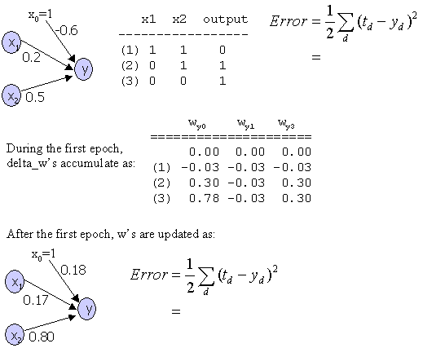
Example: the learning rate (eta) is 0.3.

Slide 16
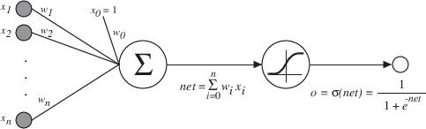

Sigmoid/Logistic function
Another continuous and differentiable function.
$o=σ(\sum_{i=0}^{n}{w_{i}∙x_{i}})$ where
$σ\left(y\right)=\frac{1}{1+e^{−y}}$

Slide 17
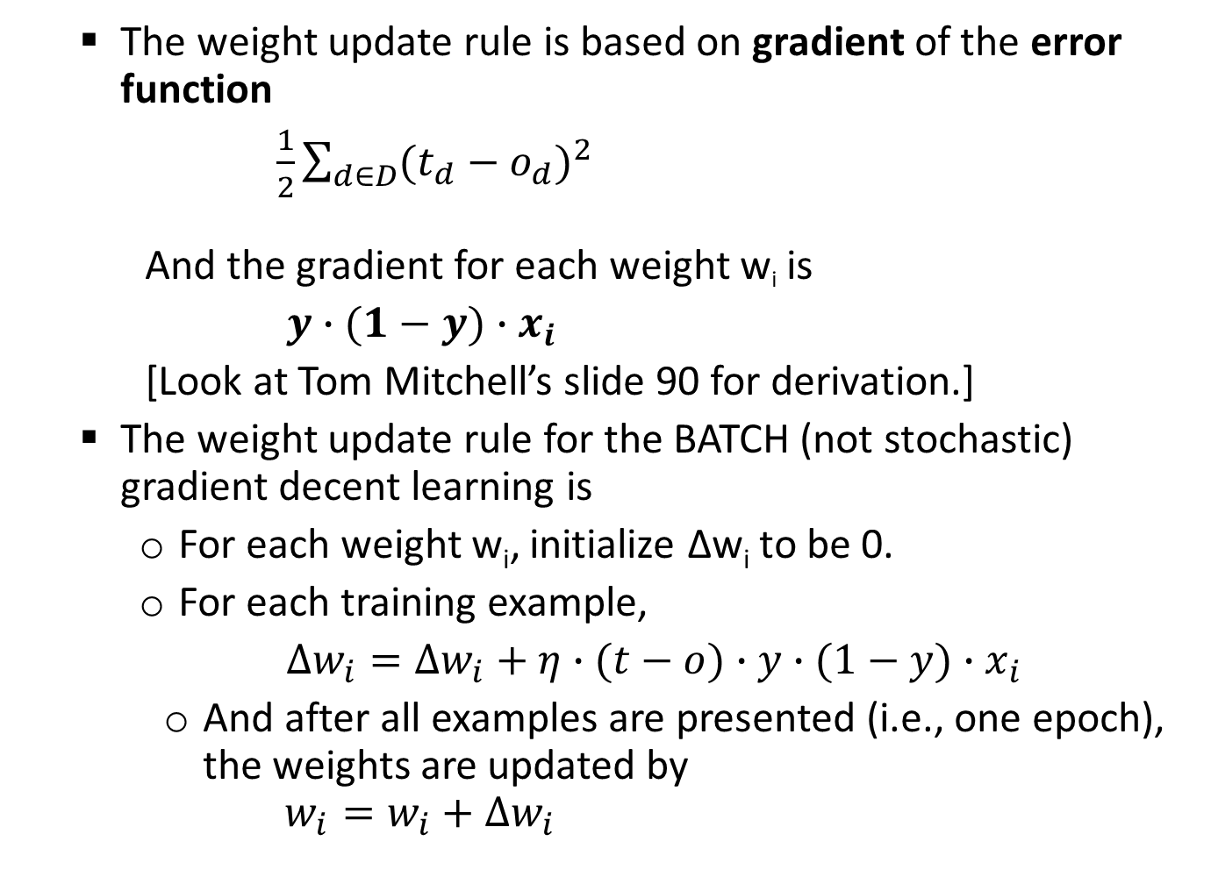
The weight update rule is based on gradient of the error function
$\frac{1}{2}\sum_{d∈D}{{(t_{d}−o_{d})}^{2}}$ And the gradient for each weight w_{i} is
$y∙(1−y)∙x_{i}$
[Look at Tom Mitchell’s slide 90 for derivation.]
The weight update rule for the BATCH (not stochastic) gradient decent learning is
For each weight w_{i}, initialize ∆w_{i} to be 0.
For each training example,
$∆w_{i}=∆w_{i}+η∙(t−o)∙y∙(1−y)∙x_{i}$
And after all examples are presented (i.e., one epoch), the weights are updated by $w_{i}=w_{i}+∆w_{i}$

Slide 18
1.4 Learning Summary
Perceptron training rule guaranteed to succeed if
Training examples are linearly separable
Sufficiently small learning rate η
Linear unit training rule uses gradient descent
Guaranteed to converge to hypothesis with minimum squared error
Given sufficiently small learning rate η
Even when training data contains noise
Even when training data not separable by H.

Slide 19
2. Backpropagation
Basic idea:
Multi-layer Feedforward networks can compute/approximate non-linear functions!!!
y_{k}
(2) Backward step:
propagate errors from output to hidden layer
δ_{k}
w_{kh}
δ_{h}
x_{h}
w_{hi}
(1) Forward step:
Propagate activation
from input to output layer
x_{i}

Slide 20
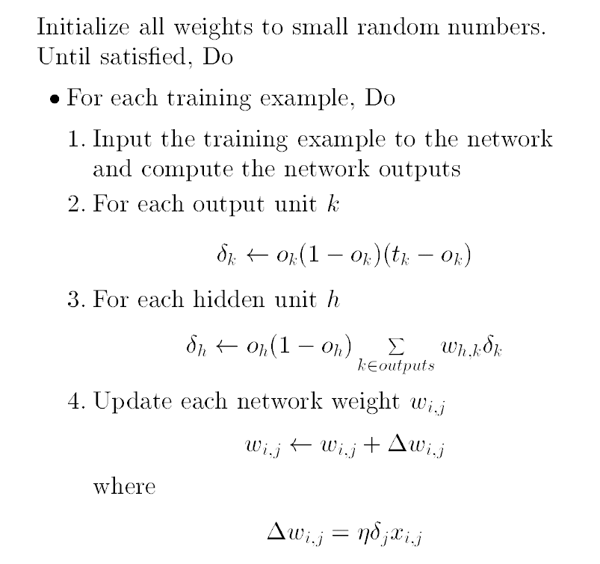
Backpropagation algorithm (Stochasitic version):
y_{k}
δ_{k}
w_{kh}
δ_{h}
x_{h}
w_{hi}
x_{i}

Slide 21
EXERCISE: For the following network,
o1
-0.04
0.05
-0.02
h1
h2
h0=-1
represents a sigmoid unit
0.03
0.02
0.02
-0.01
-0.02
0.01
i0=-1
i1
i2
Show the weights which result after an example <<1, 1>, 1> is presented. Assume the learning rate is 0.05, and stochastic weight updates.

Slide 22
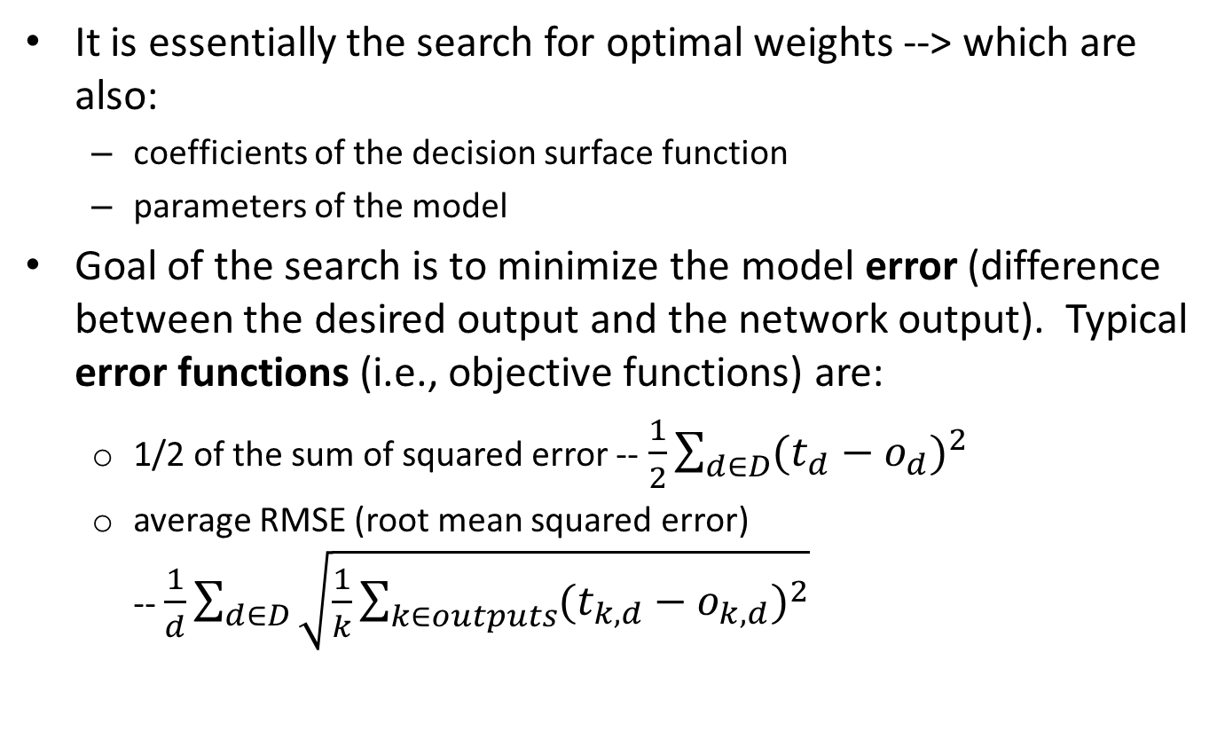
3.1 Gradient Descent on the Error Surface
It is essentially the search for optimal weights --> which are also:
coefficients of the decision surface function
parameters of the model
Goal of the search is to minimize the model error (difference between the desired output and the network output). Typical error functions (i.e., objective functions) are:
1/2 of the sum of squared error -- $\frac{1}{2}\sum_{d∈D}{{(t_{d}−o_{d})}^{2}}$
average RMSE (root mean squared error) -- $\frac{1}{d}\sum_{d∈D}{\sqrt{\frac{1}{k}\sum_{k∈outputs}{{(t_{k,d}−o_{k,d})}^{2}}}}$

Slide 23
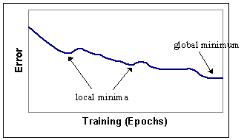
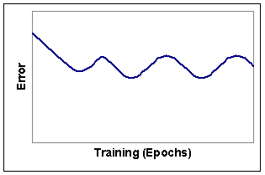
The search is done by gradient descent -- The gradient of the objective function is used to update the weights at every iteration/epoch.
Changes in the error typically show the following behavior -- the error does not decrease monotonically; it sometimes falls in local minima until the global minimum is found:
But sometimes the error oscillates and never finds the global minimum. This happens often when the learning rate is too high.

Slide 24
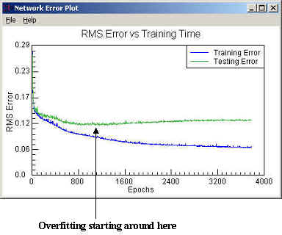
3.2 Overfitting
Training a neural network often results in overfitting -- The error is minimized (i.e., fitted) with respect to the training set, but the network does not generalize to unseen/test data.
Overfitting is a BIG problem, common in many machine learning algorithms. Some algorithms tend to suffer from it more severely than others.

Slide 25
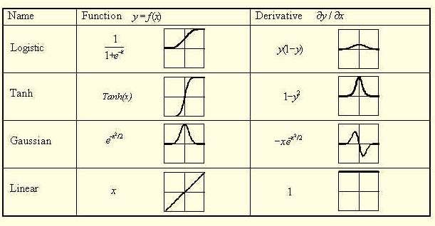
3.4 Various Activation Functions

Slide 26

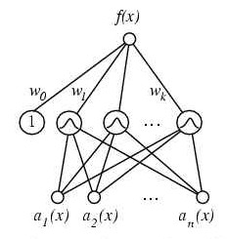
Logistic is the same as Sigmoid
Tanh (hyperbolic tangent) is It squashes the output values between 1 and -1 (i.e., bi-polar).
Gaussian is used in Radial Basis Function network (RBF).

Slide 27
4. Issues with ANN
Advantages:
Robust -- less sensitive to noise in the data
Ability to approximate complex functions
Disadvantages:
Overfitting
Difficulty of explanation -- Learned "knowledge" is the weights. What do they mean? How can we interpret them? – Black Box
Difficulty of determining the network architecture -- How can we decide on how many layers and hidden nodes to use?
Need for normalization of the data (unless incorporated in the tools).

